Slide 1
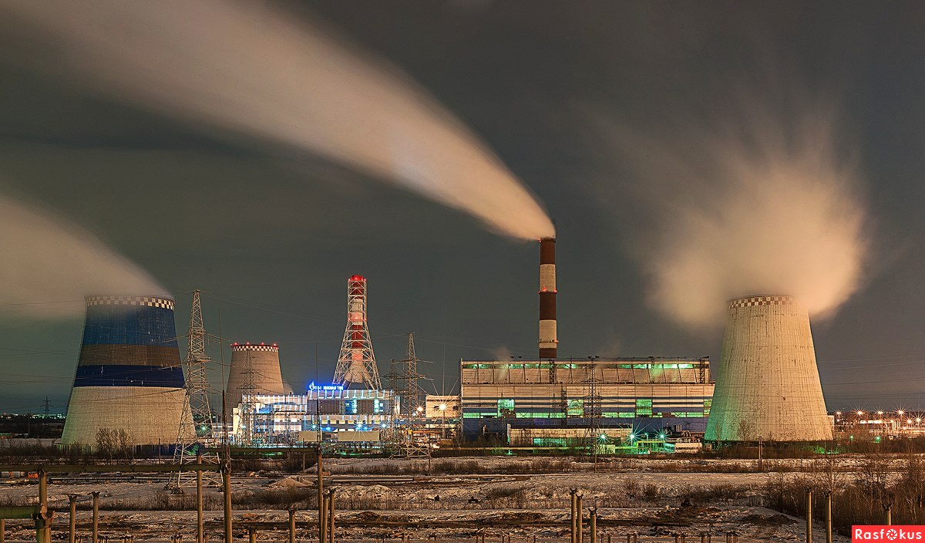

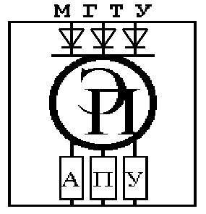
INVESTMENT DESIGN INNOVATION IN THE ENERGY SYSTEM
STATE HIGHER PROFESSIONAL EDUCATION
BELARUSIAN-RUSSIAN UNIVERSITY
DEPARTMENT
ELECTRIC DRIVE AND AUTOMATION
OF INDUSTRIAL INSTALLATIONS
course for undergraduates of the II stage of higher education specialty 1-43.80.01 "Electricity and Electrical Engineering" full-time and part-time studies
Mogilev
2021

Slide 2
INVESTMENT DESIGN INNOVATION IN THE ENERGY SYSTEM
Tutorial 13. ENERGY INVESTMENT OBJECTS
Part 2. Nuclear energy
13.1. Basic definitions, the principle of operation of nuclear power plants.
13.2. Classification of nuclear power plants
13.3. IAEA Classification
13.4. Pressurized water reactors (PWR)
13.5. Boiling water reactors (BWR)
13.6. High-Power Channel Reactor (HPCR)
13.7. World nuclear energy
13.8. Fast breeder Neutron Reactor

Slide 3
INVESTMENT DESIGN INNOVATION IN THE ENERGY SYSTEM
13.1 Basic definitions, the principle of operation of nuclear power plants.
Nuclear power plant (NPP) – a power plant based on a nuclear installation (nuclear reactor) for the production of electrical energy, which operates in strictly specified modes and conditions of use, located on the territory defined by the project. The equipment includes a nuclear reactor and a complex of necessary systems, devices, equipment and structures with specially trained personnel.

Slide 4
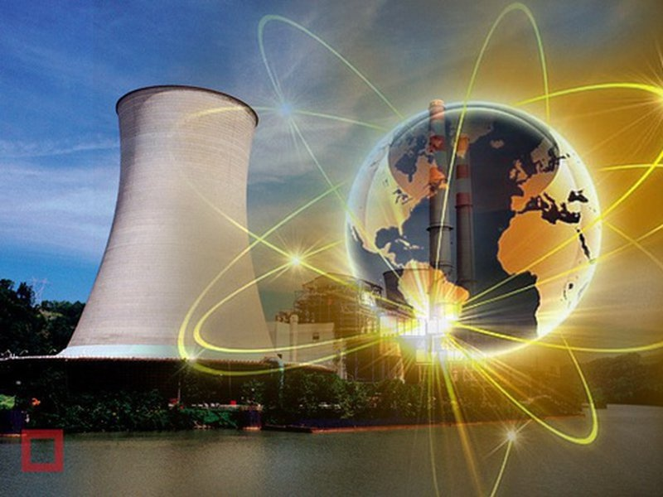
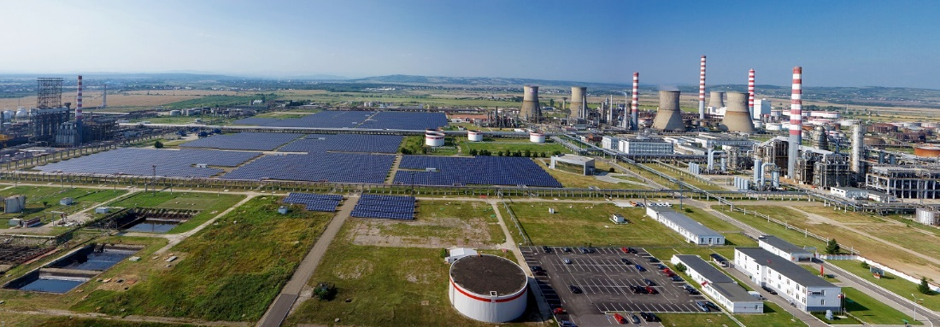
Tutorial 13. ENERGY INVESTMENT OBJECTS
Part 2. Nuclear energy
INVESTMENT DESIGN INNOVATION IN
THE ENERGY SYSTEM
Egnalinskaya NPP
Turbo-generator NPP

Slide 5
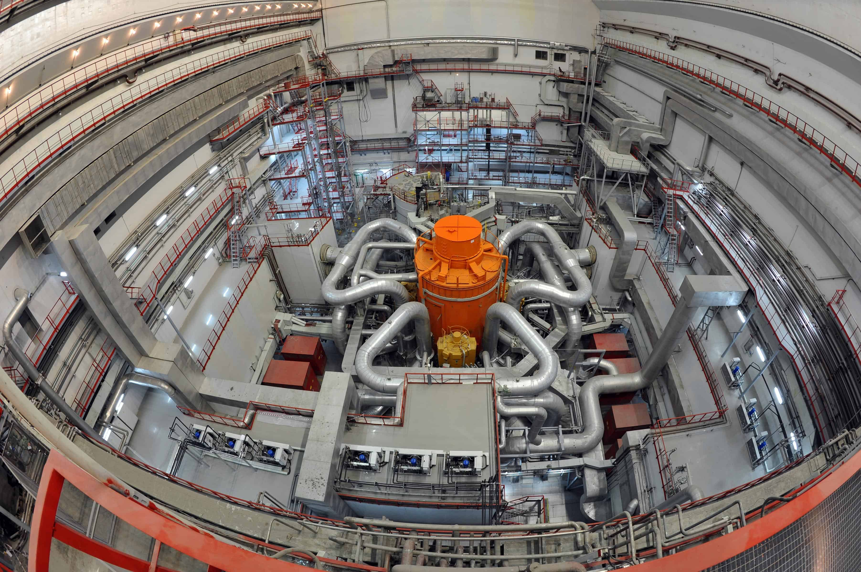
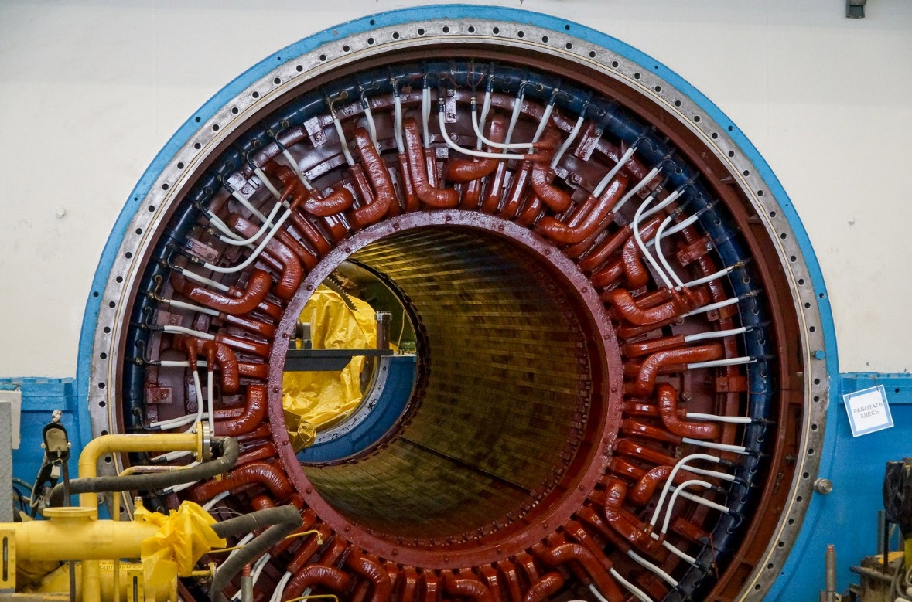
Tutorial 13. ENERGY INVESTMENT OBJECTS
Part 2. Nuclear energy
INVESTMENT DESIGN INNOVATION IN
THE ENERGY SYSTEM
Stator of generator NPP
Nuclear reactor NPP

Slide 6
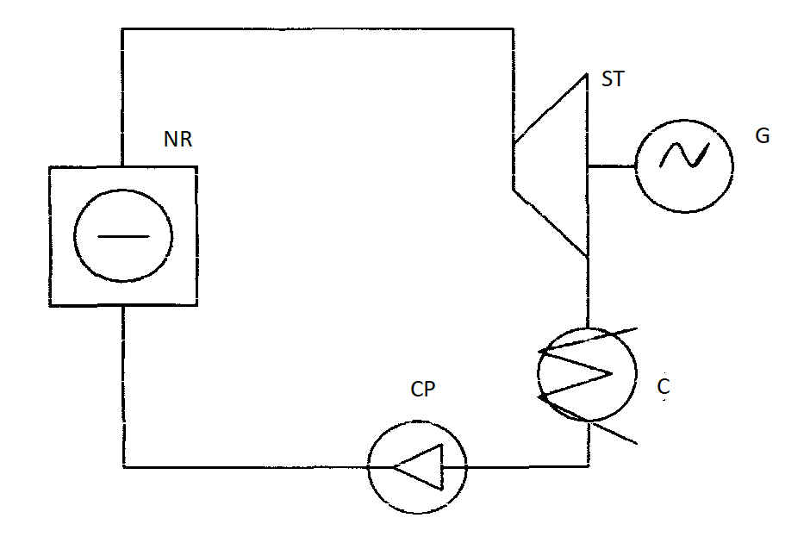
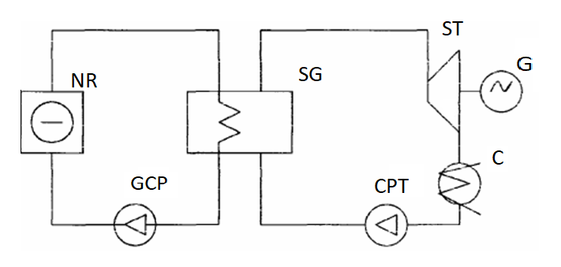
Tutorial 13. ENERGY INVESTMENT OBJECTS
Part 2. Nuclear energy
INVESTMENT DESIGN INNOVATION IN
THE ENERGY SYSTEM
Power heat scheme. 1- circuit NPP
Power heat scheme. 2- circuit NPP

Slide 7
Tutorial 13. ENERGY INVESTMENT OBJECTS
Part 2. Nuclear energy
INVESTMENT DESIGN INNOVATION IN
THE ENERGY SYSTEM
The structure of a nuclear power plant includes:
1) Nuclear reactor (NR), the main elements of which are: a heat separator, a moderator, a heat carrier.
2) Steam turbine (ST)
3) Electric generator (G)
4) Condenser or heat exchanger (C). For a 2-circuit circuit, there is (in the center of the circuit) a steam generator heat exchanger that separates the superheated steam and separates the reactor cooling circuit and the t/a steam circuit.
5) Circulation cooling pump (CP); In 2- circuit scheme – general cooling pump (GCP) & cooling pump of turbine (CPT)
The separated saturated steam enters the steam turbine. The steam used in the turbine is condensed, and the condensate is fed to the reactor by a circulation pump.
The single-circuit circuit is the simplest in terms of design and is quite economical. However, the working fluid at the exit from the reactor becomes radioactive, which imposes increased requirements for biological protection and makes it difficult to control and repair equipment.

Slide 8
Tutorial 13. ENERGY INVESTMENT OBJECTS
Part 2. Nuclear energy
INVESTMENT DESIGN INNOVATION IN
THE ENERGY SYSTEM
In a single-circuit circuit, steam is generated directly in the reactor. The resulting steam-water mixture is fed into the separator drum.
In the 2-circuit scheme, the coolant heated in the reactor enters the steam generator, where it gives its heat to the working fluid and returns to the reactor with the help of the main circulation pump. In the first circuit there is a volume compensator, which regulates the maintenance of pressure in the circuit when the temperature changes. The pressure in the first circuit is much higher than in the second. The steam produced in the steam generator is fed to the turbine, performs work in it, and condenses. The condensate is fed to the steam generator by a feed pump.
The presence of a steam generator, although it complicates the installation and reduces its efficiency, but prevents the appearance of radioactivity in the second circuit.
There is also a three-circuit circuit. It requires high costs, but ensures the safe operation of the reactor.
Nuclear fuel has a high energy (millions of times higher than organic fuel). One gram of uranium contains 2.6*10²¹ nuclei: when fission of these nuclei, energy is released, approximately equal to 2000 kW*h. To obtain this amount of energy, you need to burn more than 2000 kg. coal. Operating costs for delivery and transportation to the NPP are kept to a minimum (1 gr.Uranium ≈ 2000kg of coal).
But during the operation of the nuclear power plant itself, a large amount of radioactive substances is formed in the fuel and coolant during the operation of the nuclear reactor.
Nuclear power plants are a potential source of radiation hazard for service personnel, as well as the surrounding population

Slide 9
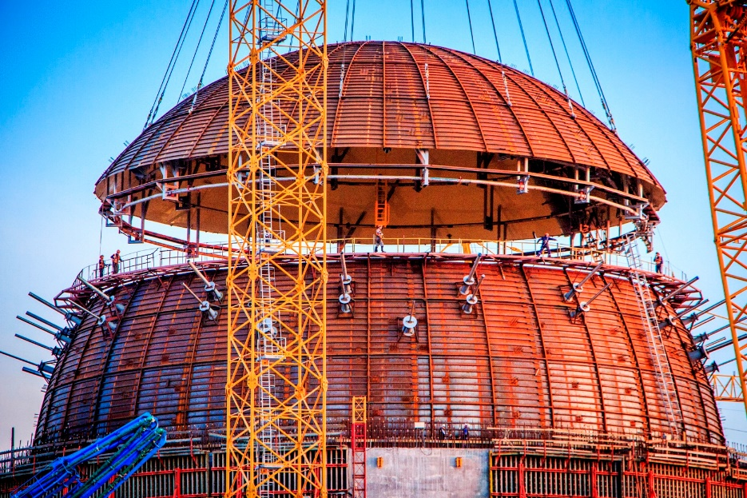
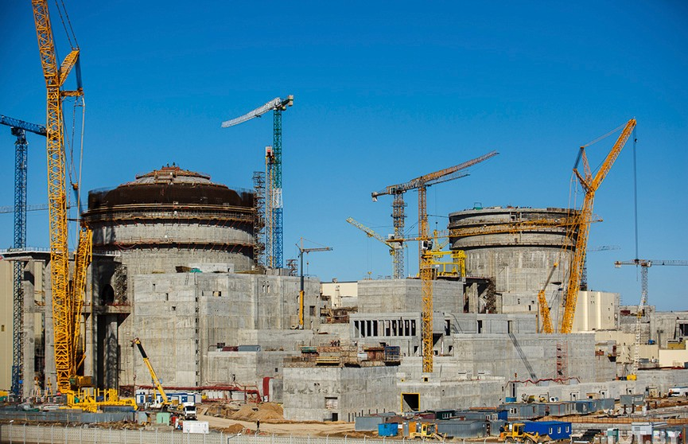
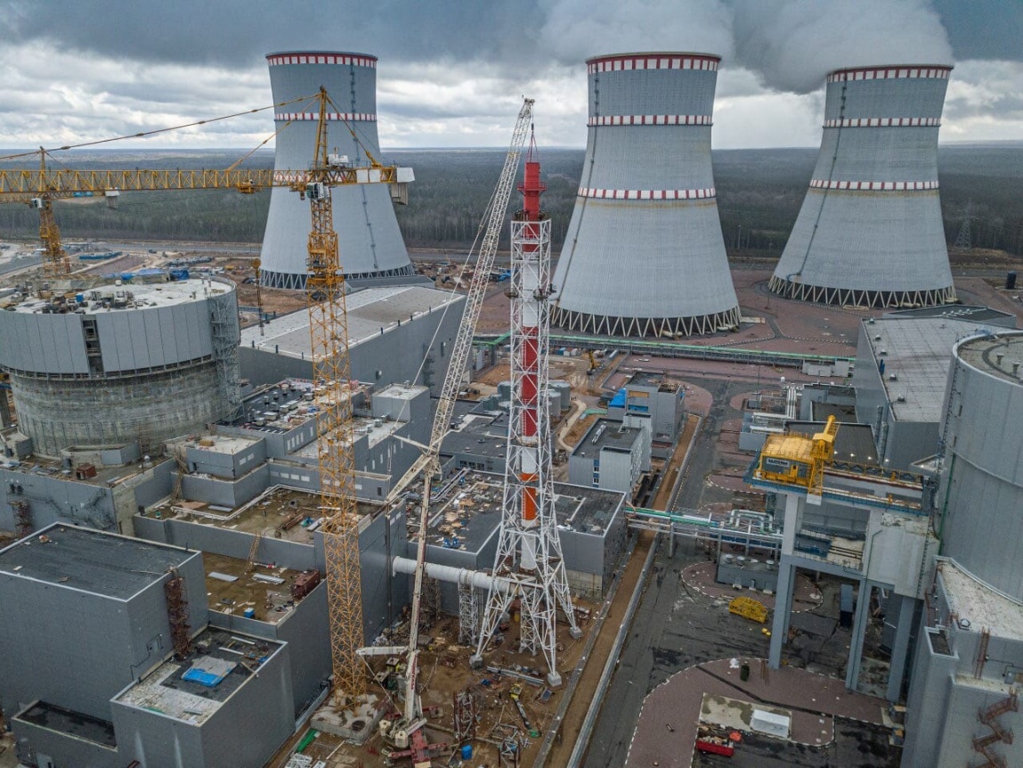
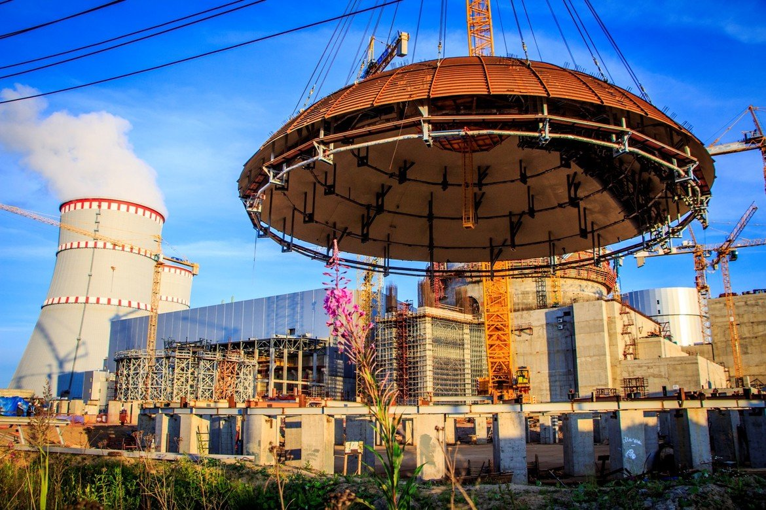
Tutorial 13. ENERGY INVESTMENT OBJECTS
Part 2. Nuclear energy
INVESTMENT DESIGN INNOVATION IN
THE ENERGY SYSTEM
Construction of a nuclear power plant

Slide 10
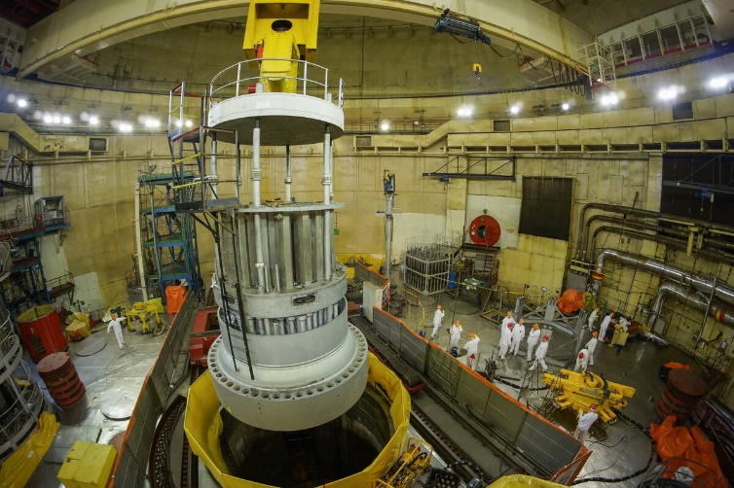
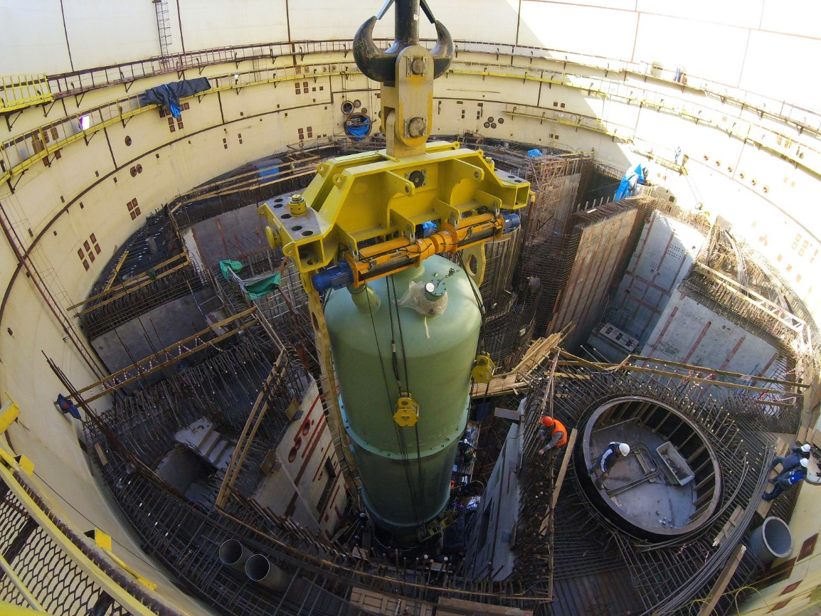
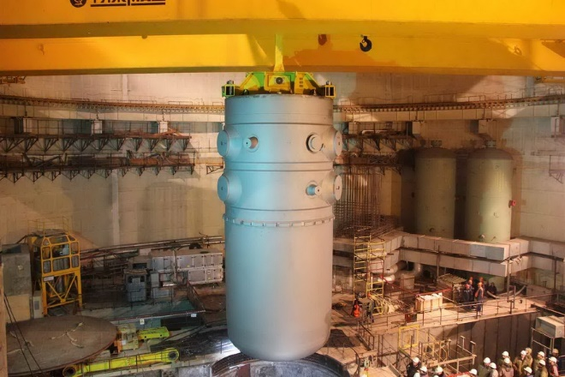
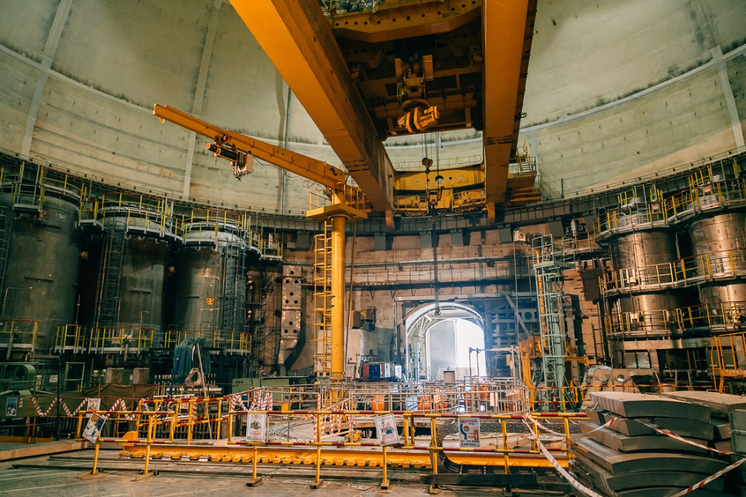
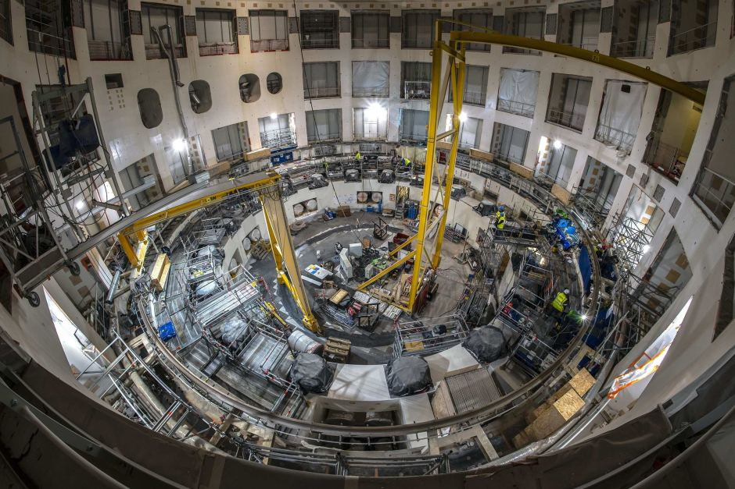
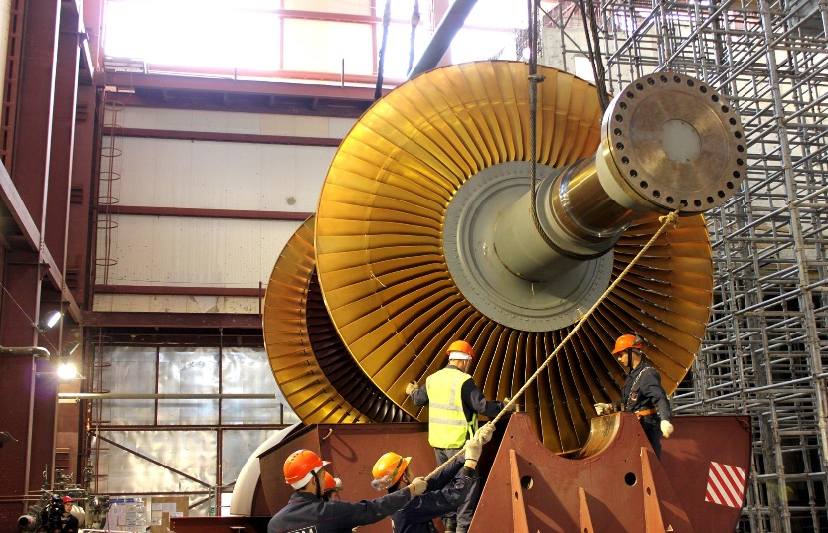
Tutorial 13. ENERGY INVESTMENT OBJECTS
Part 2. Nuclear energy
INVESTMENT DESIGN INNOVATION IN
THE ENERGY SYSTEM
Construction of a nuclear power plant

Slide 11
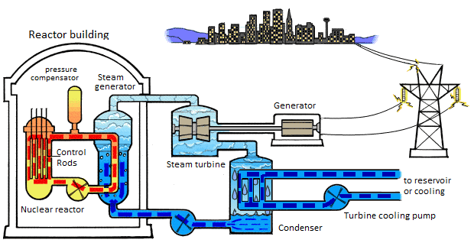
INVESTMENT DESIGN INNOVATION IN THE ENERGY SYSTEM
13.2 Classification NPP
By the type of energy released
Nuclear power plants by the type of energy released can be divided into:
- Nuclear power plants (NPPs) designed to generate electrical energy. At the same time, many nuclear power plants have heating plants designed to heat the network water, using the heat losses of the station.
- Nuclear thermal power plants (NTPPs) that generate both electricity and heat.
Scheme of operation of a nuclear power plant on a double-circuit water-water power reactor (PWR)

Slide 12
Tutorial 13. ENERGY INVESTMENT OBJECTS
Part 2. Nuclear energy
INVESTMENT DESIGN INNOVATION IN
THE ENERGY SYSTEM
By the neutron spectrum
Thermal (slow) neutron reactor - a "thermal reactor" - is a nuclear reactor that uses neutrons from the thermal part of the energy spectrum – "thermal spectrum" - to maintain a nuclear chain reaction. The use of thermal spectrum neutrons is advantageous because the cross-section of the interaction of uranium-235 nuclei with neutrons involved in the chain reaction increases as the neutron energy decreases, and the uranium-238 nuclei remain constant at low energies. As a result, a self-sustaining reaction using natural uranium, in which the fissionable isotope 235U is only 0.7%, is impossible on fast neutrons (fission spectrum) and possible on slow (thermal) ones.
Fast neutron reactor ("fast reactor" – a nuclear reactor that uses neutrons with an energy of > 10⁵ eV (1eV_{(electron*Volt)} = 1.6×10-19 J) to maintain a nuclear chain reaction)
At the location of the fuel
1. Heterogeneous reactors, where the fuel is placed in the core discretely in the form of blocks, between which there is a moderator;
2. Homogeneous reactors, where the fuel and moderator are a homogeneous mixture (homogeneous system).

Slide 13
Tutorial 13. ENERGY INVESTMENT OBJECTS
Part 2. Nuclear energy
INVESTMENT DESIGN INNOVATION IN
THE ENERGY SYSTEM
By type of fuel:
• Isotopes of uranium 235 and 233 (²³⁵U and ²³³U)
• Isotope of plutonium 239 (²³⁹Pu)
• Isotope of thorium 232 (²³²Th) (by conversion to ²³³U)
By type of heat carrier
• H2O (water, see Water-water reactor)
•Gas, Graphite-gas reactor
• D2O (heavy water, see Heavy water nuclear Reactor),
• Liquid metal heat transfer reactor (LCT-a nuclear reactor that uses molten metal as a heat transfer medium
• Molten salt reactor ((liquid salt reactor, ZHSR, MSR)
• Nuclear reactor with a solid coolant – a nuclear reactor, the working fluid of the coolant of which, instead of water, is a material based on pyrolysis carbon.

Slide 14
Tutorial 13. ENERGY INVESTMENT OBJECTS
Part 2. Nuclear energy
INVESTMENT DESIGN INNOVATION IN
THE ENERGY SYSTEM
By type of moderator
• C (graphite, see Graphite-gas reactor, Graphite-water reactor)
• H2O (water, see Light-water reactor, Water-water reactor, WWER)
• D2O (heavy water, see Heavy Water Nuclear Reactor, CANDU)
• Be, BeO
• Hydrides (compounds of hydrogen with metals and with non-metals having a lower electronegativity than hydrogen. For example, hydrogen compounds with halides, nitrogen, oxygen, carbon, and sulfur are not metal hydrides
• Without moderator (Fast Neutron reactor)
By design
• Hull reactors (reactor, the core is located inside a cylindrical housing)
• Channel reactors. (without housing)
By the method of generating steam
• Reactor with external steam generator (Water-water reactor, WWER)
• Boiling Water Reactor (BWR) is a type of water-water reactor in which steam is generated directly in the core and sent to the turbine.

Slide 15
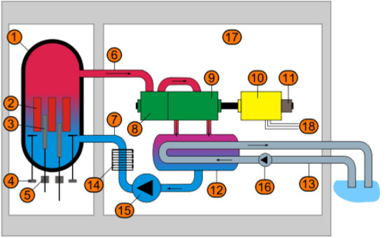
Tutorial 13. ENERGY INVESTMENT OBJECTS
Part 2. Nuclear energy
INVESTMENT DESIGN INNOVATION IN
THE ENERGY SYSTEM
Boiling Water Reactor (BWR)
1. Reactor vessel
2. Fuel assemblies
3. The rods of the control and protection
4. Circulation pumps
5. Control rod drives
6. Steam to the turbine
7. Make-up water
8. The high-pressure cylinder of the turbine
9. The low-pressure cylinder of the turbine
10. Turbo generator
11. Pathogen
12. The capacitor
13. Condenser cooling water
14. Make-up water heater
15. Feed pump
16. Condensate pump
17. Reinforced concrete fence
18. Connection to the electrical network
In addition to this type of reactor, fluidized channel nuclear reactors of the graphite-water type, for example, high-power channel reactor – HPCR (LWGR by IAEA), can be fluidized.

Slide 16
Tutorial 13. ENERGY INVESTMENT OBJECTS
Part 2. Nuclear energy
INVESTMENT DESIGN INNOVATION IN
THE ENERGY SYSTEM
Distinctive features
In nuclear power plants with non-boiling reactors, the water temperature in the primary circuit is lower than the boiling point. At the temperatures necessary to obtain an acceptable efficiency (more than 300 °C), this is possible only at high pressures (WWER-1000 (PWR by IAEA), the working pressure in the housing is 160 atm), which requires the creation of a high-strength housing. Saturated water vapor at a pressure of 12-60 atm at a temperature of up to 330 °C is produced in the second circuit. In boiling reactors, the steam-water mixture is produced in the core. The water pressure in the primary circuit is about 70 atm. At this pressure, the water boils in the core volume at a temperature of 280 °C. Boiling reactors have a number of advantages compared to non-boiling ones. In boiling reactors, the housing operates at a lower pressure, and there is no steam generator in the NPP circuit.
The peculiarity of boiling reactors is that they do not have boron regulation, compensation for slow changes in reactivity (for example, fuel burnout) is made only by cross-shaped intercasset absorbers. Boron regulation is not feasible due to the good solubility of boron in steam (most of it will be carried away to the turbine). Boron is introduced only for the time of fuel overload to create a deep subcriticality.

Slide 17
Tutorial 13. ENERGY INVESTMENT OBJECTS
Part 2. Nuclear energy
INVESTMENT DESIGN INNOVATION IN
THE ENERGY SYSTEM
In most fluidized reactors, the control and protection system's absorbing rods are located at the bottom. Thus, their efficiency is significantly increased, since the maximum of the thermal neutron flux in this type of reactor is shifted to the lower part of the core. Such a scheme is also more convenient for fuel overloads and frees the upper part of the reactor from the (Control and protection system (CPS) drives, thus allowing for more convenient steam separation).

Slide 18
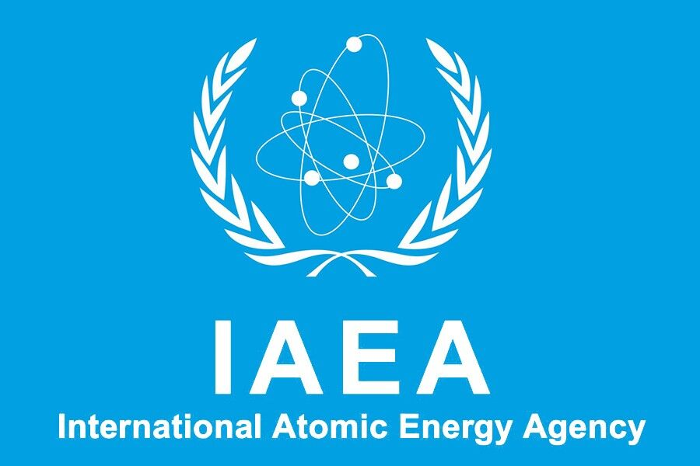
INVESTMENT DESIGN INNOVATION IN THE ENERGY SYSTEM
13.3 IAEA Classification
International Atomic Energy Agency — IAEA
Headquarters Vienna, Austria
The member states of the International Atomic Energy Agency (IAEA) are those states which have joined the international organization that seeks to promote the peaceful use of nuclear energy, and to inhibit its use for any military purpose, including nuclear weapons. The IAEA was established as an autonomous organization on 29 July 1957. Though established independently of the United Nations through its own international treaty, the IAEA Statute,[1] the IAEA reports to both the UN General Assembly and Security Council. During 1956, an IAEA Statute Conference was held to draft the founding documents for the IAEA, and the IAEA Statute was completed at a conference in 1957.

Slide 19
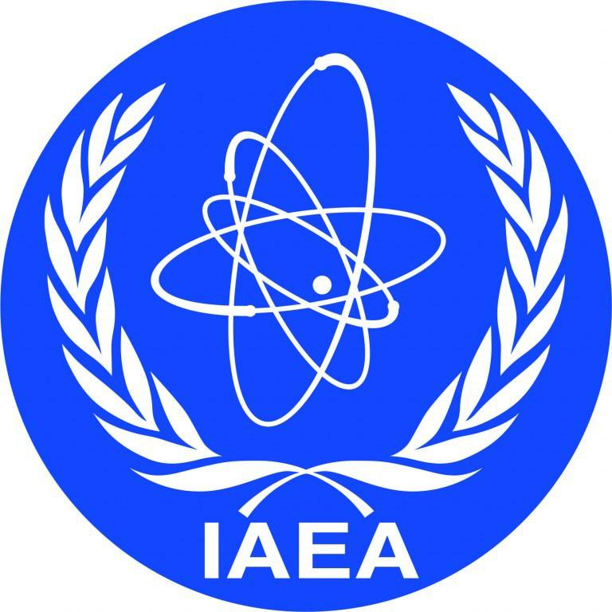
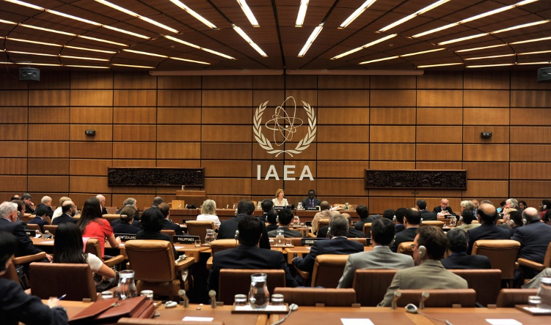
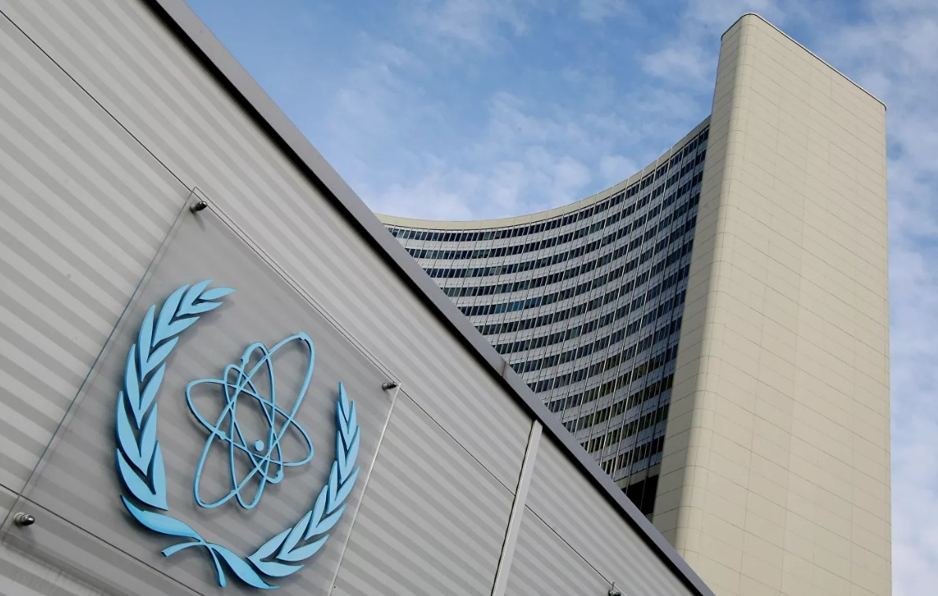
Tutorial 13. ENERGY INVESTMENT OBJECTS
Part 2. Nuclear energy
INVESTMENT DESIGN INNOVATION IN
THE ENERGY SYSTEM

Slide 20
Tutorial 13. ENERGY INVESTMENT OBJECTS
Part 2. Nuclear energy
INVESTMENT DESIGN INNOVATION IN
THE ENERGY SYSTEM
The purpose of the Agency's work in the country is to state that work in the peaceful nuclear field does not switch to military purposes. By signing such an agreement, the state guarantees that it does not conduct military-oriented research, which is why this document is called a guarantee agreement. At the same time, the IAEA is a purely technical body. It cannot give a political assessment of the activities of a particular State. The IAEA has no right to speculate — the Agency works only with irrefutable facts, basing its conclusions solely on the tangible results of inspections. The IAEA safeguards system cannot physically prevent the transfer of nuclear material from peaceful to military purposes, but only allows the detection of the transfer of material under safeguards or the misuse of a facility under safeguards and initiates a review of such facts in the UN. At the same time, the Agency's conclusions are extremely cautious and correct.
The Agency's functions include:
• Promotion of research and development in the field of peaceful uses of nuclear energy;
• Encouraging the exchange of scientific achievements and methods;
• Creation and implementation of a system of guarantees that civil nuclear programs and developments will not be used for military purposes;;
• Development, establishment and adaptation of occupational health and safety standards.

Slide 21
Tutorial 13. ENERGY INVESTMENT OBJECTS
Part 2. Nuclear energy
INVESTMENT DESIGN INNOVATION IN
THE ENERGY SYSTEM
IAEA Classification
• PWR (pressurized water reactors) – water-water reactor (reactor with water under pressure);
• BWR (boiling water reactor);
• FBR (fast breeder reactor);
• GCR (gas-cooled reactor);
• LWGR (light water graphite reactor) – graphite-water reactor (a heterogeneous nuclear reactor that uses graphite as a moderator and ordinary water as a coolant. According to the uranium-graphite scheme, the first experimental and industrial reactors were made, as well as reactors for nuclear power plants, including the reactor. The world's first nuclear power plant was a uranium-graphite (Reactor). Currently, several civil power nuclear power plants with uranium-graphite reactors are operating, including high-power channel reactor HPCR -type reactors.
• PHWR (pressurized heavy water reactor)
The most common in the world are water-water (about 62 %) and boiling (20 %) reactors.

Slide 22
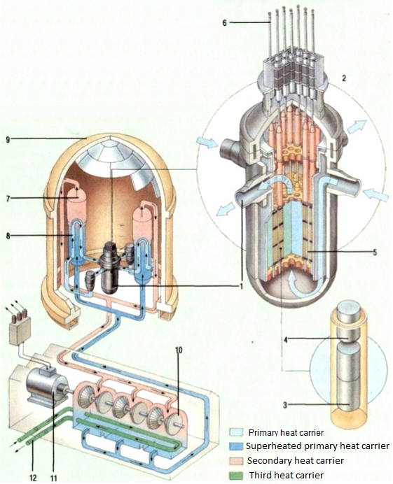
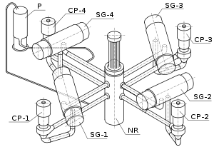
INVESTMENT DESIGN INNOVATION IN THE ENERGY SYSTEM
13.4 WWER (PWR by IAEA)
WWER (Water-Water Power Reactor) is a two-circuit water-water hull power nuclear reactor with pressurized water, one of the most successful branches of the development of nuclear power plants, which has become widespread in the world.

Slide 23
Tutorial 13. ENERGY INVESTMENT OBJECTS
Part 2. Nuclear energy
INVESTMENT DESIGN INNOVATION IN
THE ENERGY SYSTEM
Scheme of the first circuit with the WWER-1000/1200.
The pressurized water reactor is so named because the first coolant (1) passing through the core of the nuclear reactor (2) is under pressure, which prevents it from boiling. The fuel, uranium-235, is loaded into the reactor in capsules ("tablets") (3) placed in fuel rods (4). To prevent an uncontrolled chain reaction, the fuel rods are separated by graphite control rods (5). All rods are loaded into the reactor from above (6). The first heat carrier is heated by the fission reaction taking place in the fuel rods, and is sent to the steam generator (7), where it overheats the second heat carrier. The second heat carrier (8) leaves the protective vessel (9) and rotates the turbine (10), which, by means of a generator (11), produces electricity. The third heat carrier (12) cools the second heat carrier by transferring heat to the sea, river or lake. Reducing the temperature of the second coolant increases the efficiency of heat transfer from the first to the second coolant The attached photo shows the core of the nuclear reactor (dark steep zone) during the charging period-when the first fuel load is placed in the reactor core.

Slide 24
Tutorial 13. ENERGY INVESTMENT OBJECTS
Part 2. Nuclear energy
INVESTMENT DESIGN INNOVATION IN
THE ENERGY SYSTEM
Fuel element (fuel element) is the main structural element of the core of a heterogeneous nuclear reactor containing nuclear fuel. In fuel rods, the heavy nuclei ²³⁵U, ²³⁹Pu or ²³³U are divided, accompanied by the release of thermal energy, which is then transferred to the heat carrier. Fuel rods consist of a fuel core, a shell, and end parts. The type of fuel element is determined by the type and purpose of the reactor, the parameters of the coolant. The fuel element must provide reliable heat removal from the fuel to the heat carrier.
In most modern power reactors, the fuel rod is a rod with a diameter of 9.1-13.5 mm and a length of several meters.

Slide 25
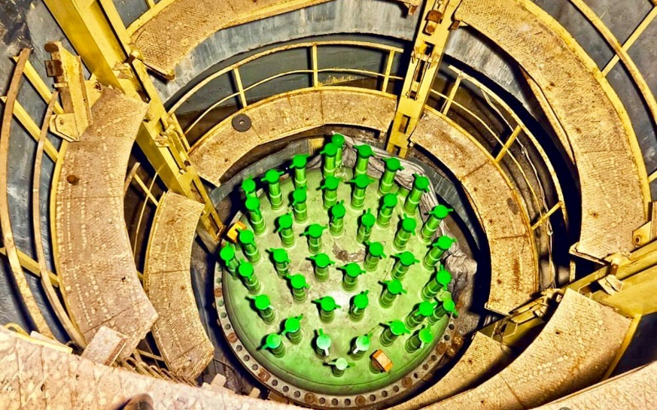
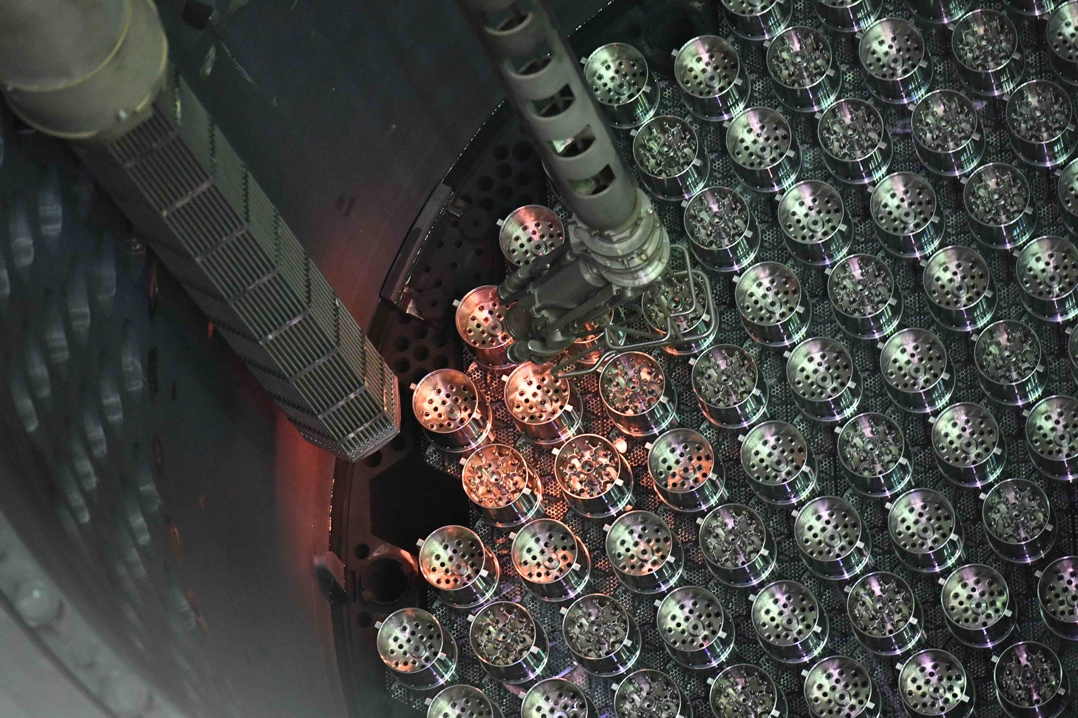
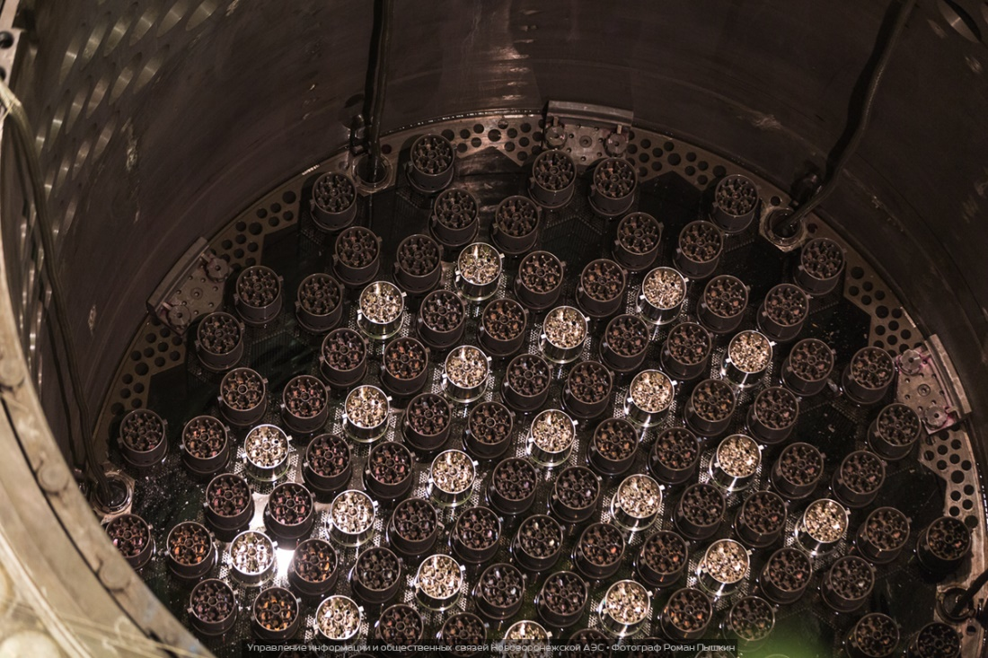
Tutorial 13. ENERGY INVESTMENT OBJECTS
Part 2. Nuclear energy
INVESTMENT DESIGN INNOVATION IN
THE ENERGY SYSTEM
Fuel element

Slide 26
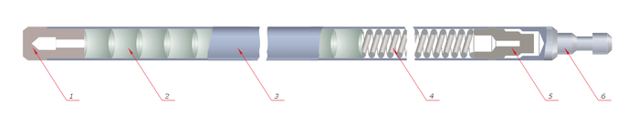
Tutorial 13. ENERGY INVESTMENT OBJECTS
Part 2. Nuclear energy
INVESTMENT DESIGN INNOVATION IN
THE ENERGY SYSTEM
Reactor fuel element device: 1-plug; 2-uranium dioxide tablets; 3 – zirconium shell; 4-spring; 5-sleeve; 6-tip.
Inside the fuel rods, heat is released due to the nuclear fission reaction of the fuel and the interaction of neutrons with the substance of the core materials and the coolant, which is transferred to the coolant. Structurally, each fuel element consists of a core and a sealed shell.
In addition to the fissile material (²³³U, ²³⁵U, ²³⁹Pu), the core may contain a substance that ensures the reproduction of nuclear fuel (²³³U, ²³⁵U, ²³⁹Pu).
A good sealing of the fuel element shell is necessary to avoid the ingress of fuel fission products into the coolant, which can lead to the spread of radioactive elements outside the core. Also, due to the fact that uranium, plutonium and their compounds are extremely chemically active, their chemical reaction with water can lead to deformation of fuel rods and other undesirable consequences.

Slide 27
Tutorial 13. ENERGY INVESTMENT OBJECTS
Part 2. Nuclear energy
INVESTMENT DESIGN INNOVATION IN
THE ENERGY SYSTEM
Main WWER indicators on the example of WWER-1200 (NPP 2006)
It is characterized by the following characteristics:
The WWER-1200 core consists of 163 fuel cartridges, each with 312 fuel rods. 18 guide tubes are arranged evenly along the cassette.
The weight of the reactor vessel is about 330 tons.
WWER-1200 and the equipment of the primary circuit with a radioactive coolant are placed in a protective shell made of prestressed reinforced concrete, called a hermetic shell or container. It ensures the safety of the unit in case of accidents with the rupture of the primary circuit pipelines.
Average fuel output 45.5 kW/kg,
Electric power 1200 MW, coolant
Pressure in the reactor vessel 15.7 MPa;
Speed of the coolant for cooling fuel rods is 5 m/s.
Fuel burn-up increased to 50 MW day/kg U (in the future, the average fuel burn-up will be increased to 70 MW day/kg U). It is important to create highly reliable reactor vessels made of materials with increased radiation resistance.

Slide 28
Tutorial 13. ENERGY INVESTMENT OBJECTS
Part 2. Nuclear energy
INVESTMENT DESIGN INNOVATION IN
THE ENERGY SYSTEM
One of the engineering ideas expressed in the design of the WWER-1200 reactor: the unit will be equipped with a passive heat removal system. With the help of such a system, it is possible, quite safely for the population and staff, to divert heat, devoid of any presence of CO₂, into the air space, which is an almost infinite heat sink. The original "novelty" of the nuclear unit is also that all the equipment and radioactive substances will be concentrated under a double reinforced concrete shell, absolutely sealed. In the event of an emergency, this will keep all the "dirt" inside, in complete isolation from the outside world. The double shell is also an anti-terrorist device, it is designed to withstand the fall of an airplane. In case of an emergency situation, the design also provides a trap for molten fuel.

Slide 29
Tutorial 13. ENERGY INVESTMENT OBJECTS
Part 2. Nuclear energy
INVESTMENT DESIGN INNOVATION IN
THE ENERGY SYSTEM
Advantages and disadvantages
The main advantage is the practical independence from fuel sources due to the small amount of fuel used.
A huge advantage of the nuclear power plant is its relative environmental cleanliness. So, coal power plants, equal in nuclear capacity, throwing for 50 years, the amount of radioactive waste is equal to the volume of spent fuel during the same period, subject to disposal; i.e. coal plant gives more specific (per unit of electricity produced) the release of radioactive substances.
The only factor in which nuclear power plants are inferior in environmental terms to traditional CHPP is thermal pollution caused by high consumption of process water for cooling turbines, which is compensated by NTPP, artificial reservoirs (fish farming, oyster farming, greenhouse heating) or modern cooling towers. All this also makes it possible to obtain an efficiency similar to that of a CHPP.
The cost of building a nuclear power plant is about the same level as the construction of a thermal power plant, or slightly higher.
The main drawback of nuclear power plants is the severe consequences of accidents.
A serious problem for nuclear power plants is their elimination after the resource is exhausted, according to estimates, it can amount to up to 20 % of the cost of their construction.
For a number of technical reasons, it is highly undesirable for nuclear power plants to operate in maneuverable modes, that is, to cover the variable part of the electrical load schedule.
Cumulative coefficient (installed capacity utilization factor) for all operating power units: high-power channel reactor HPCR -69.71 %; WWER – 71.54 %.

